Slide 1
Information Visualization Session 2: Asking the Question

Slide 2
Agenda
Finding the appropriate data
Organize your data
Basic charting

Slide 3
Agenda
Excel is your new best friend

Slide 4



Static Data Sets
Complete downloadable files
Usually in Comma Separated Value (csv) format or Excel files
Specific data, limited to a topic

Slide 5




Custom Data Sets
Data saved in online databases
Accessible through online forms or API calls
Accessing APIs usually requires some programming experience

Slide 6
pick a topic for your story

Slide 7
Start With a Topic
Education
Finance
Demographics
Polling
Elections
Music

Slide 8
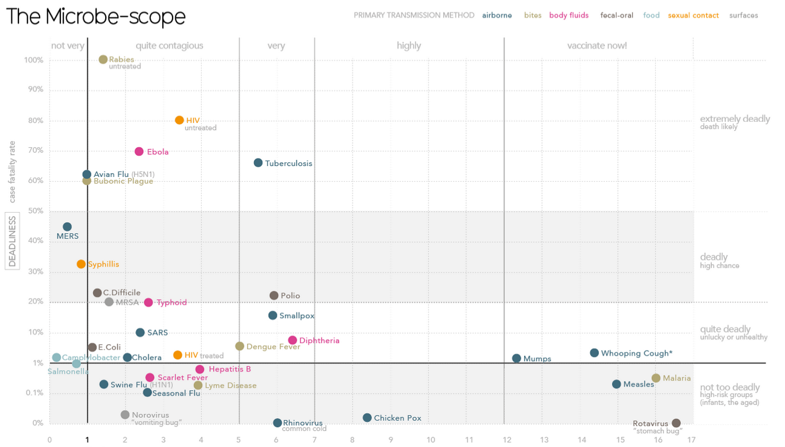
Start With the Data You Can Find
Working with existing data will raise questions
You may have to collect the “missing link”
http://www.informationisbeautiful.net/
visualizations/the-microbescope/

Slide 9
find the data

Slide 10
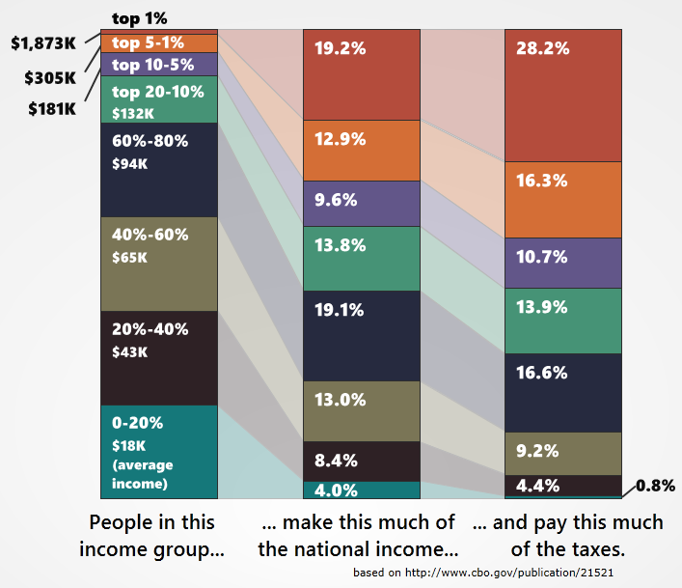
Economic Data
FRED – Federal Reserve Bank
of St. Louis Economic Data
http://research.stlouisfed.org/
CBO.gov
http://www.cbo.gov/
http://politicalmathblog.com/?p=1735

Slide 11
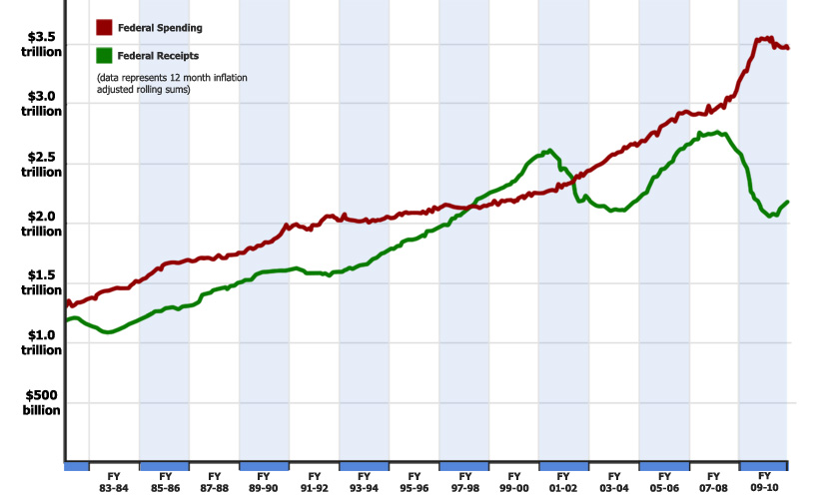
Federal Spending Data
Monthly Treasury
Statement
http://www.fiscal.treasury.gov/
fsreports/rpt/mthTreasStmt/
backissues.htm
CBO.gov
http://www.cbo.gov/

Slide 12
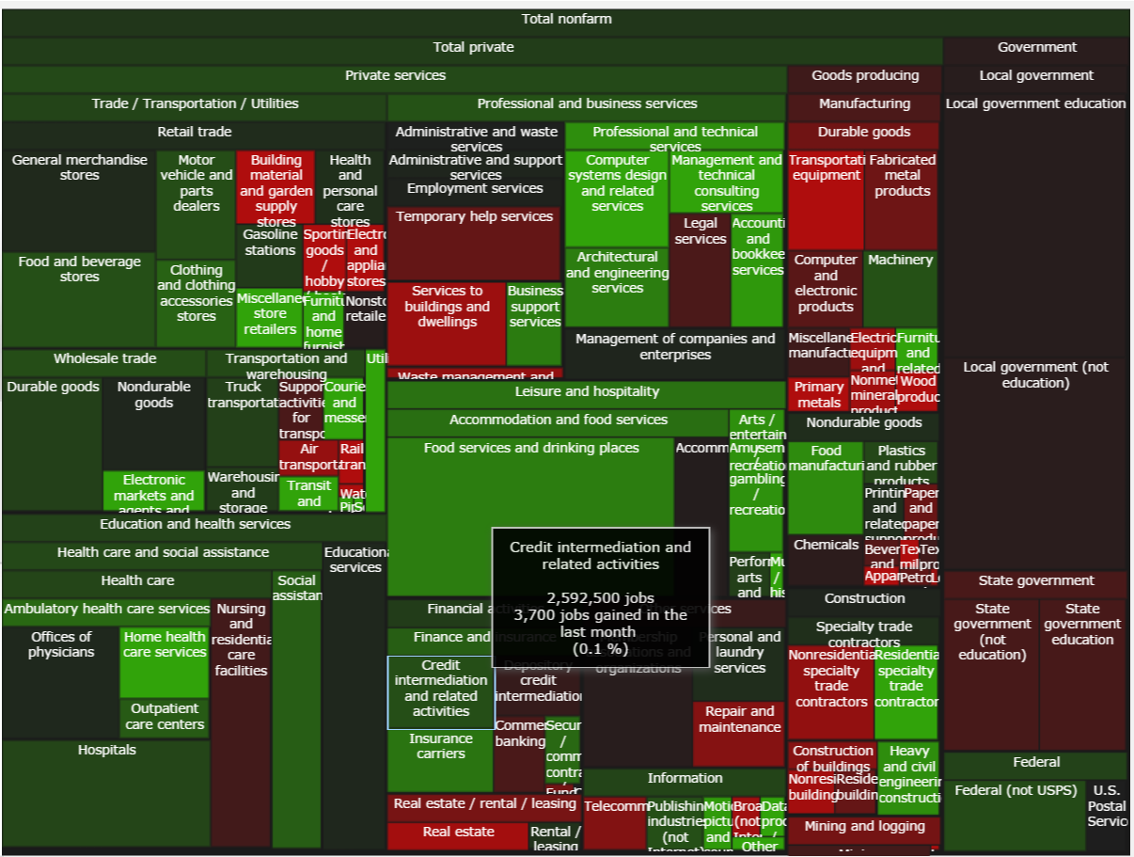
Employment Data
Bureau of Labor Statistics
http://www.bls.gov/data/
http://politicalmathblog.com/BLS/2012/08/

Slide 13
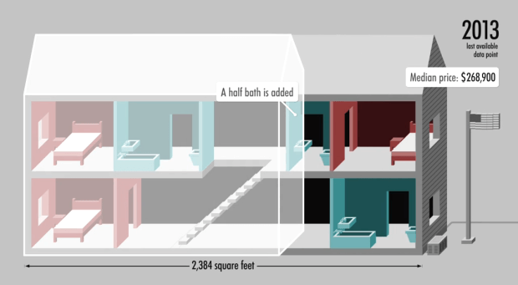
Demographics Data
Census.gov
http://www.census.gov/
data.html
http://money.cnn.com/interactive/pf/40-years-american-home/

Slide 14
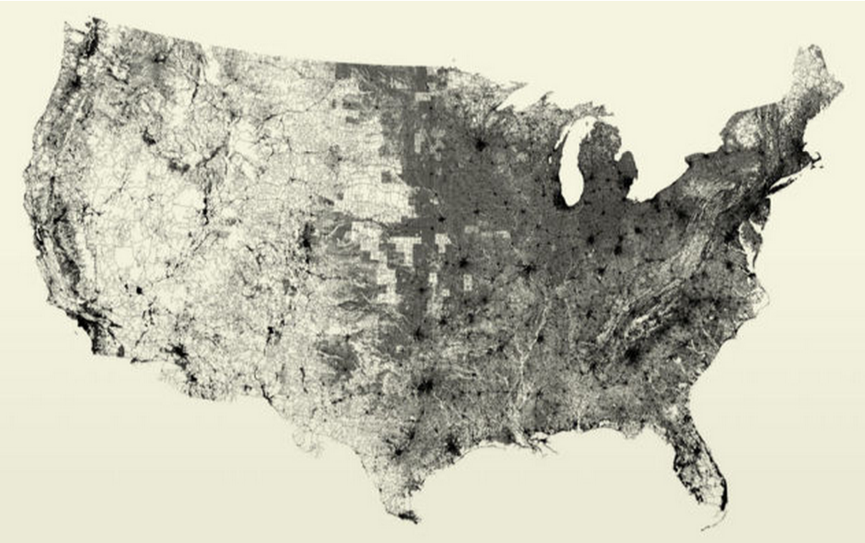
All the Data
https://www.data.gov/open-gov/

Slide 15
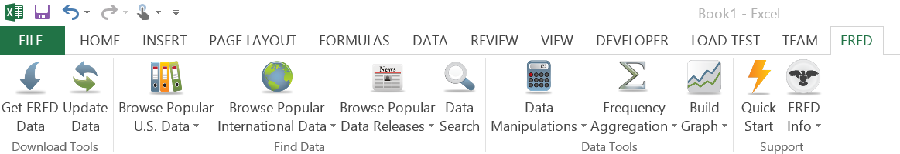
FRED Data – Excel Add-In
http://research.stlouisfed.org/fred-addin/

Slide 16
APIs
http://www.opensecrets.org/resources/create/
http://developer.nytimes.com/docs
http://sunlightfoundation.com/api/

Slide 17
You will need: Excel The interwebs

Slide 18
organizing your data

Slide 19
Organize In Excel
Calculating an average
Rolling averages
Transposing data
Copying values (not equations)
Exporting data
Sorting with Excel
Basic conditional investigation

Slide 20
Calculate an Average
=AVERAGE(A1:A12)
Demo

Slide 21
Calculate “per unit” values
[very large number] / [unit]
Example:
Federal spending =per_day/24 =per_minute/60
=spending/365 =per_hour/60

Slide 22
Calculate “per unit” values
[very large number] / [unit]
Example:
Federal spending =spending/households
=spending/population =spending/employed

Slide 23
Rolling Sums / Averages
On sequential data (daily, weekly, monthly)
=SUM(A1:A12)
drag the formula down using handles

Slide 24
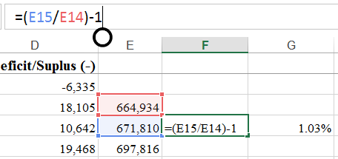
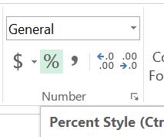
Calculating Percentages
Relative changes often more meaningful than absolute changes
=(A2/A3)-1
“%” formatting
Increase / decrease
significant digits

Slide 25
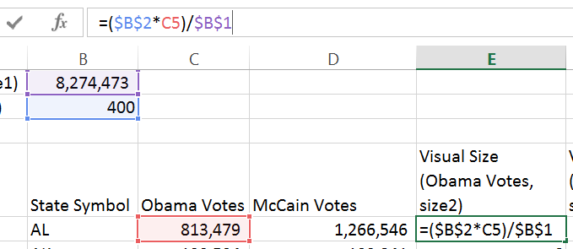
Excel Syntax
Using the ‘$’ operand.
‘$’ means “stop moving”

Slide 26
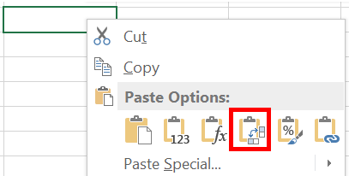
Transposing Data
Copy-Paste data to swap rows/columns

Slide 27
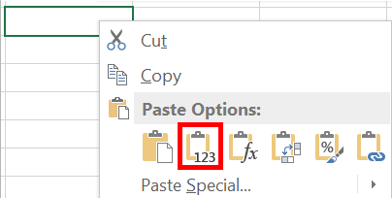
Copying Values
Strip out formulas from cells
Retain only the calculated values
Valuable for moving data from sheet to sheet

Slide 28
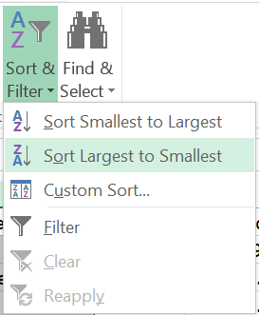
Sorting in Excel
Select a column
“Sort & Filter”
Always “expand selection”

Slide 29
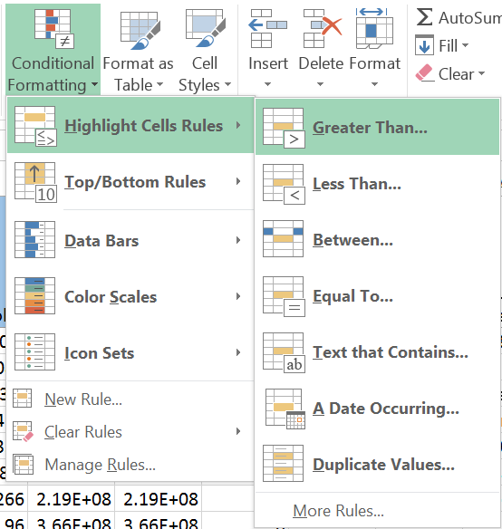
Conditional Investigation
Highlight cells with certain data

Slide 30
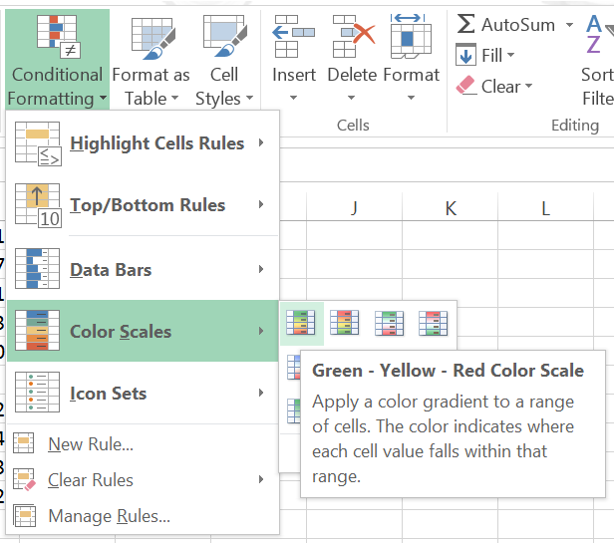
Conditional Investigation
Using Color Scales

Slide 31
basic charting

Slide 32
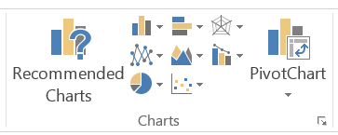
Simple Excel charting
Frequent starting point for a data visualization
Good for data exploration
Different styles reveal different stories

Slide 33
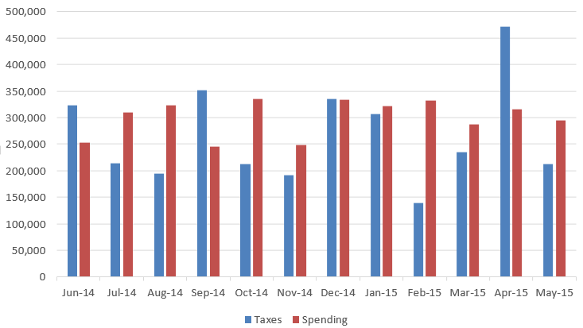
Simple bar chart
Values stack on
each other
Used to show all parts of a sum

Slide 34
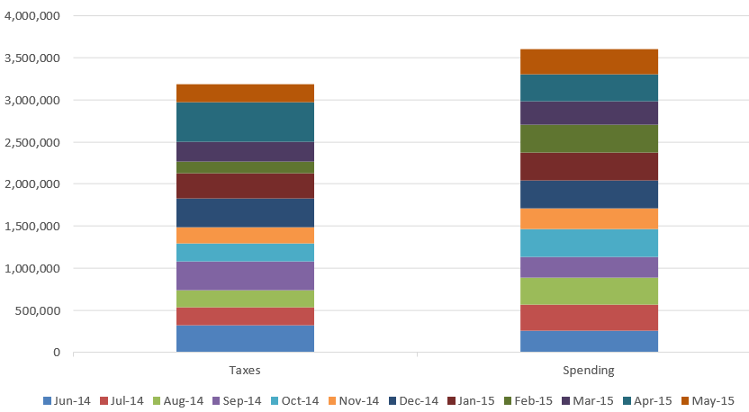
Additive charts
Values stack on
each other
Used to show all parts of a sum

Slide 35
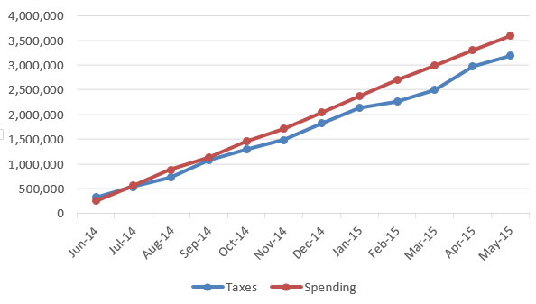
Line Charts
Simple and clean
Excellent for indicating trend lines in data

Slide 36
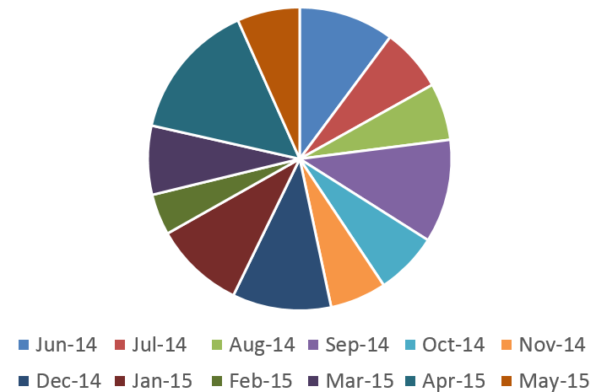
Pie Charts
Show parts of a whole
Keep it to very few parts
Often despised

Slide 37
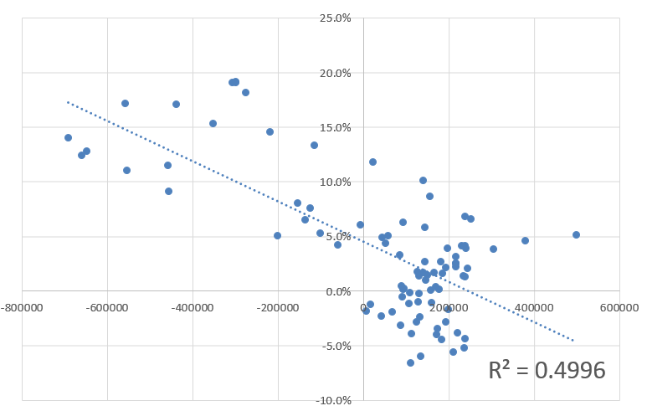
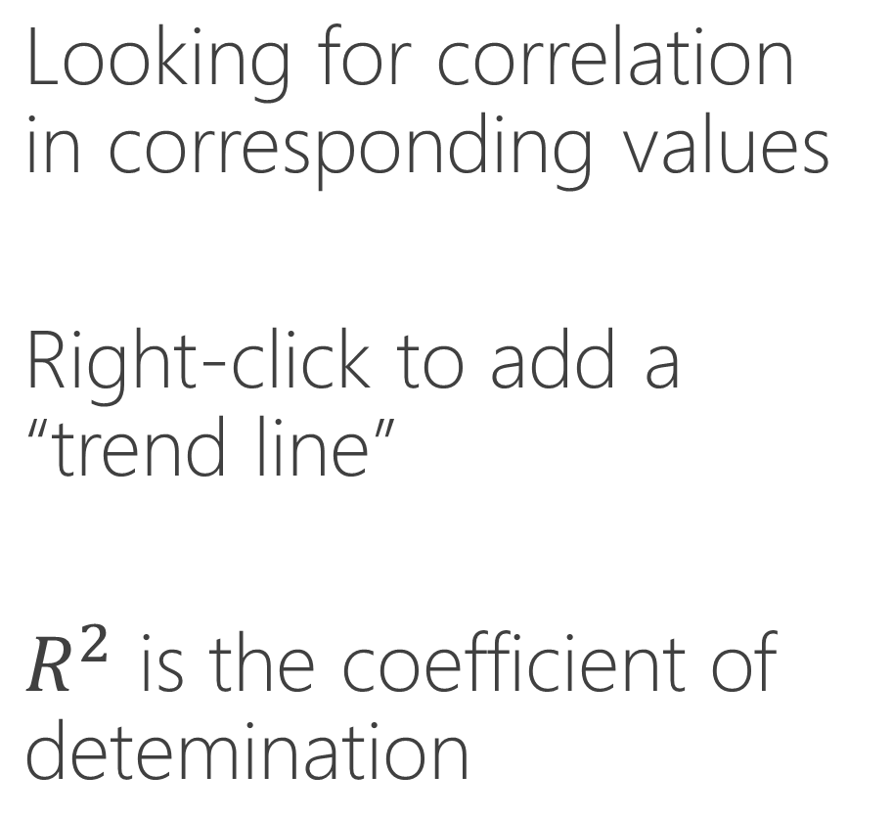
Multi Variate Charts
Looking for correlation in corresponding values
Right-click to add a “trend line”
$R^{2}$ is the coefficient of detemination

Slide 38
Lab 2
Pull jobs data from BLS
Organize multi-sheet data set
Visualize within Excel
Relative vs. Absolute differences

